Slide 1


Fundamentals of Surveying
Theory and Samples Exercises

Slide 2
Definition of Surveying
•
Surveying has to do with the determination of the relative spatial location of points on or near the surface of the earth.
It is the art of measuring horizontal and vertical distances between objects, of measuring angles between lines, of determining the direction of lines, and of establishing points by predetermined angular and linear measurements.
Along with the actual survey measurements are the mathematical calculations.
Distances, angles, directions, locations, elevations, areas, and volumes are thus determined from the data of the survey.
Survey data is portrayed graphically by the construction of maps, profiles, cross sections, and diagrams.
•
•
•
•
The importance of the Surveying
Land surveying is basically an art and science of mapping and measuring land. The entire scope of profession is wide; it actually boils down to calculate where the land boundaries are situated. This is very important as without this service, there would not have been railroads, skyscrapers could not have been erected and neither any individual could have put fences around their yards for not intruding others land.
2

Slide 3
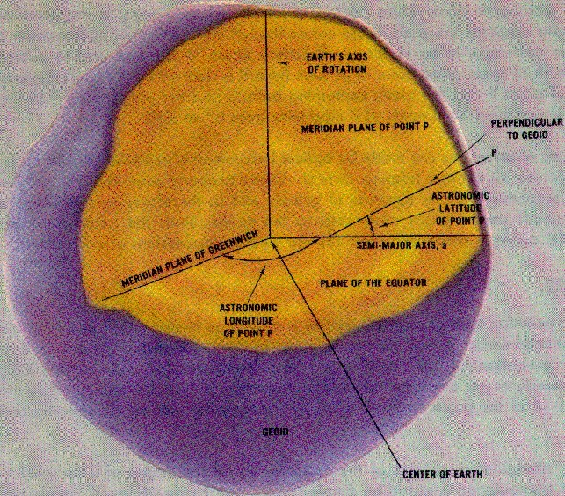
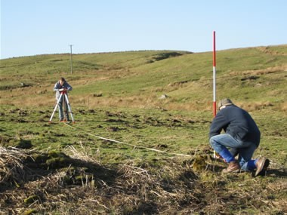
Types of Surveying
Geodetic Surveying:
The type of surveying that takes into account the true shape of the earth. These surveys are of high precision and extend over large areas.
Plane Surveying:
The type of surveying in which the mean surface of the earth is considered as a plane, or in which its spheroidal shape is neglected, with regard to horizontal distances and directions.
3

Slide 4
Different methods of Surveying
•
•
Control Survey: Made to establish the horizontal and vertical positions of arbitrary points.
Boundary Survey: Made to determine the length and direction of land lines and to establish the position of these lines on the ground.
Topographic Survey: Made to gather data to produce a topographic map showing the configuration of the terrain and the location of natural and man-made objects.
Hydrographic Survey: The survey of bodies of water made for the purpose of navigation, water supply, or sub-aqueous construction.
Mining Survey: Made to control, locate and map underground and surface works related to mining operations.
Construction Survey: Made to lay out, locate and monitor public and private engineering works.
Route Survey: Refers to those control, topographic, and construction surveys necessary for the location and construction of highways, railroads, canals, transmission lines, and pipelines.
Photogrammetric Survey: Made to utilize the principles of aerial photogrammetry, in which measurements made on photographs are used to determine the positions of photographed objects.
Astronomical survey: generally involve imaging or "mapping" of regions of the sky using telescopes.
•
•
•
•
•
•
•
4

Slide 5
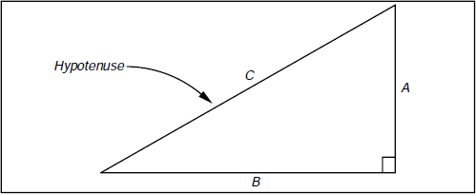
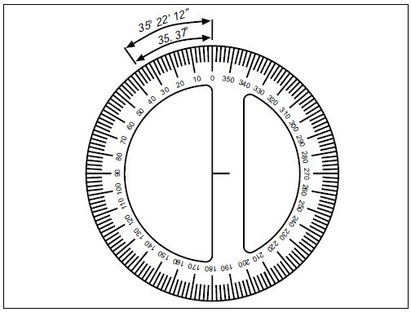
Basic Trigonometry functions for Distance and Angular Measurements
Pythagorean Theorem
In a right triangle, the square of the hypotenuse is equal to the sum of the squares of the other two sides.
C ² = A² + B²
where: C is the hypotenuse (side opposite the right
angle). A and B are the remaining sides.
Units of Angular Measurement
The most common angular units being employed in the United States is the Sexagesimal System.
This system uses angular notation in increments of 60 by dividing the circle into 360 degrees; degrees into 60 minutes; and minutes into 60
seconds.
Therefore;
1 circle = 360° = 21,600´ = 1,296,000˝
1° = 60´ = 3600˝
1´ = 60˝
5

Slide 6
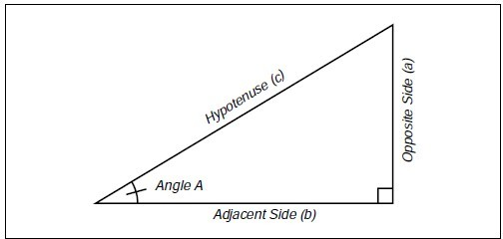
Most useable functions of Trigonometry
All trigonometric functions are simply ratios of one side of a right triangle to a second side of the same triangle, or one side over another side. The distinction between functions is which two sides are compared in the ratio.
The figure below illustrates the side opposite from and the side adjacent to Angle A, and the
hypotenuse (the side opposite the right angle). The trigonometric functions of any angle are by definition:
Sine A = Opposite Side / Hypotenuse cosine A= Adjacent Side / Hypotenuse Tangent A = Opposite Side / Adjacent Side
and inverting each ratio, we have
cosecant = Hypotenuse / Opposite Side = 1/sine A secant = Hypotenuse / Adjacent Side = 1/cosine A cotangent = Adjacent Side / Opposite Side = 1/tangent A
6

Slide 7
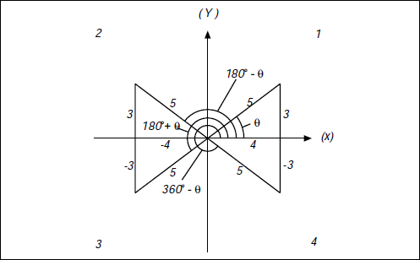
Algebraic Signs of the Trigonometric Functions in each Quadrant
Using the definitions on the previous page, we can determine the values of the functions for each angle shown below. List the Sine, Cosine, and Tangent of each angle in both fractional and decimal form.
Quadrat 1
Tanθ = 3/4 = 0.7500
Quadrat 2
Sin 180-θ = 3/5 = 0.6000 Cos 180-θ = -4/5 = -0.8000 Tan 180-θ = 3/-4 = -0.7500
Quadrat 3
Sin 180+ θ = -3/5 = -0.6000 Cos 180+ θ = -4/5 = -0.8000 Tan 180+ θ = -3/-4 = 0.7500
Quadrat 4
Sin 360-θ = -3/5 = -0.6000 Cos 360-θ = 4/5 = 0.8000
Tan 360-θ = -3/4 = -0.7500
7

Slide 8
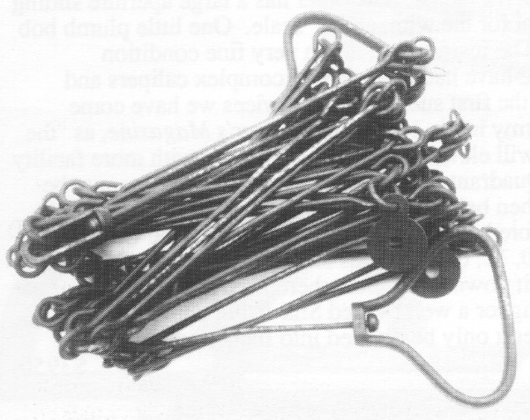
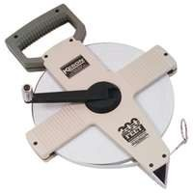
Distance Measuring (Chaining surveying)
English mathematician Edmund Gunter (1581-1626) gave to the world not only the words cosine and cotangent, and the discovery of magnetic variation, but the measuring device called the Gunter’s chain shown below. Edmund also gave us the acre which is 10 square chains.
The Gunter’s chain is 1/80th of a mile or 66 feet long. It is composed of 100 links, with a link being 0.66 feet or 7.92 inches long. Each link is a steel rod bent into a tight loop on each end and connected to the next link with a small steel ring.
Starting in the early 1900’s surveyors started using steel tapes to measure distances. These devices are still called “chains” to this day.
8

Slide 9
Procedure of Chaining
•
It must be remembered in surveying, that under most circumstances, all distances are presumed to be horizontal distances and not surface distances.
•
This dictates that every field measurement taken be either measured horizontally or, if not, reduced to a horizontal distance mathematically.
•
In many instances, it is easiest to simply measure the horizontal distance by keeping both ends of the chain at the same elevation. This is not difficult if there is less than five feet or so of elevation change between points. A hand level or “pea gun” is very helpful for maintaining the horizontal position of the chain when “level chaining.” A pointed weight on the end of a string called a “plumb bob” is used to carry the location of the point on the ground up to the elevated chain by simply suspending the plumb bob from the chain such that the point of the plumb bob hangs directly above the point on the ground.
•
When the difference in elevation along the measurement becomes too great for level chaining, other methods are called for. One option, “break chaining”, involves simply breaking the measurement into two or more measurements that can be chained level.
9

Slide 10
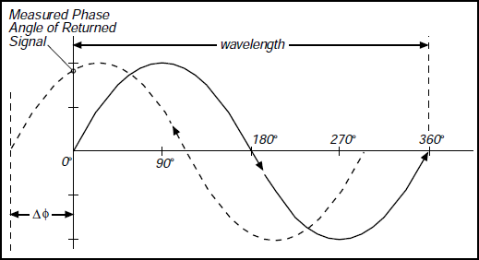
Distance Measuring (Electronic Distance Meters)
In the early 1950’s the first Electronic Distance Measuring (EDM) equipment were developed. These primarily consisted of electro-optical (light waves) and electromagnetic (microwave) instruments. They were bulky, heavy and expensive. The typical EDM today uses the electro-optical principle. They are small, reasonably light weight, highly accurate, but still expensive.
Principle of Chaining
To measure any distance, you simply compare it to a known or calibrated distance; for example by using a scale or tape to measure the length of an object.
In EDM’s the same comparison principle is used.
The calibrated distance, in this case, is the wavelength of the modulation on a carrier wave.
Modern EDM’s use the precision of a Quartz Crystal Oscillator and the measurement of phase-shift to determine the distance.
The EDM is set up at one end of the distance to be measured and a reflector at the other end.
The EDM generates an infrared continuous-wave carrier beam, which is modulated by an electronic shutter (Quartz crystal oscillator).
This beam is then transmitted through the aiming optics to the reflector.
The reflector returns the beam to the receiving optics, where the incoming light is converted to an electrical signal, allowing a phase comparison between transmitted and received signals.
The amount by which the transmitted and received wavelengths are out of phase, can be measured electronically and registered on a meter to within a millimeter or two.
•
•
•
•
•
•
•

Slide 11
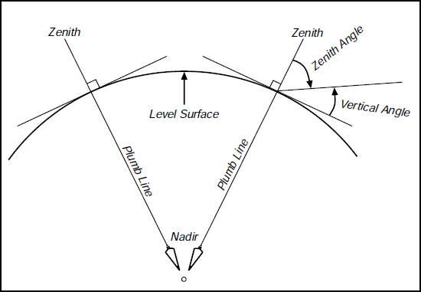
Angle Measuring
Measuring distances alone in surveying does not establish the location of an object. We need to locate the object in 3 dimensions. To accomplish that we need:
Horizontal length (distance)
Difference in height (elevation)
Angular direction.
An angle is defined as the difference in direction between two convergent lines. A horizontal angle is formed by the directions to two objects in a horizontal plane. A vertical angle is formed by two intersecting lines in a vertical plane, one of these lines horizontal. A zenith angle is the complementary angle to the vertical angle and is formed by two intersecting lines in a vertical plane, one of these lines directed toward the zenith.

Slide 12
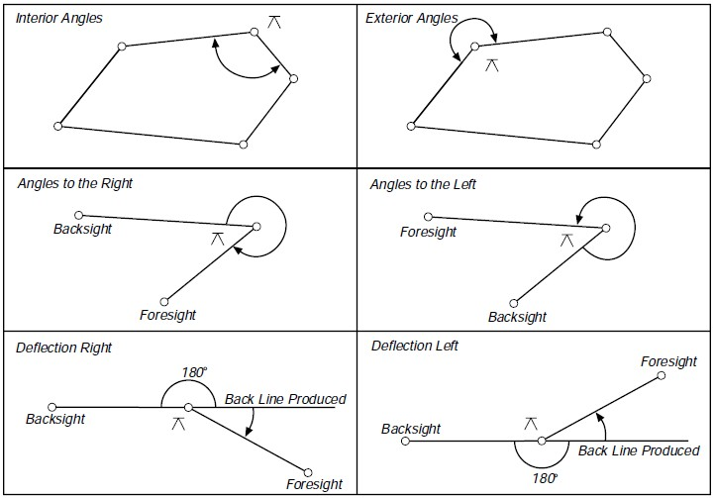
Types of Measured Angles
•
Interior angles are measured clockwise or counter-clockwise between two adjacent lines on the inside of a closed polygon figure.
Exterior angles are measured clockwise or counter-clockwise between two adjacent lines on the outside of a closed polygon figure.
Deflection angles, right or left, are measured from an extension of the preceding course and the ahead line. It must be noted when the deflection is right (R) or left (L).
•
•

Slide 13
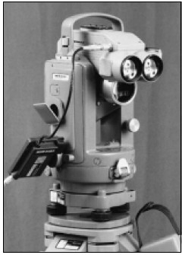
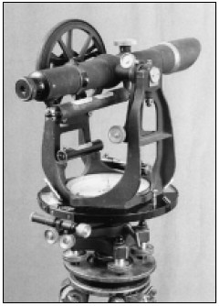
A Theodolite is a precision surveying instrument; consisting of an alidade with a telescope and an accurately graduated circle; and equipped with the necessary levels and optical-reading circles. The glass horizontal and vertical circles, optical-reading system, and all mechanical parts are enclosed in an alidade section along with 3 leveling screws contained in a detachable base or tribrach.
A Transit is a surveying instrument having a horizontal circle divided into degrees, minutes, and seconds. It has a vertical circle or arc. Transits are used to measure horizontal and vertical angles. The graduated circles (plates) are on the outside of the instrument and angles have to be read by using a vernier.

Slide 14
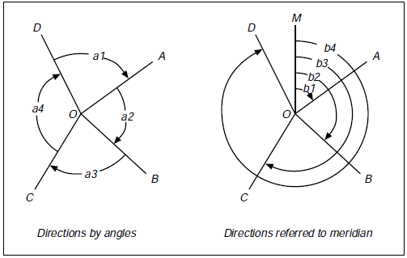
Bearings and Azimuths
The Relative directions of lines connecting survey points may be obtained in a variety of ways. The figure below on the left shows lines intersecting at a point. The direction of any line with respect to an adjacent line is given by the horizontal angle between the 2 lines and the direction of rotation.
The figure on the right shows the same system of lines but with all the angles measured from a line of reference (O-M). The direction of any line with respect to the line of reference is given by the
angle between the lines and its direction of rotation.

Slide 15
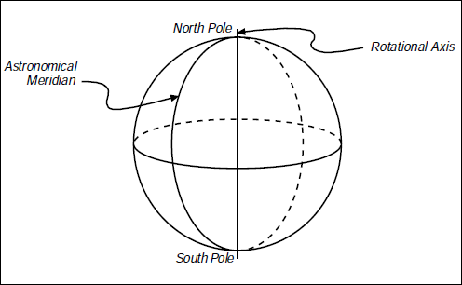
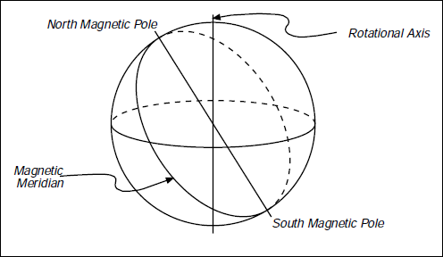
The line of reference (Meridian)
There are several types of meridians: Astronomical or True, Magnetic, Grid, and Assumed.
Astronomical or True Meridians
A plane passing through a point on the surface of the earth and containing the earth’s axis of rotation defines the astronomical or true meridian at that point. Astronomical meridians are determined by observing the position of the sun or a star. For a given point on the earth, its direction is always the same and therefore directions referred to the astronomical or true meridian remain unchanged. This makes it a good line of reference.
Astronomical or true meridians on the surface of the earth are lines of geographic longitude and they converge toward each other at the poles. The amount of convergence between meridians depends on the distance from the equator and the longitude between the meridians.
Magnetic Meridian
A magnetic meridian lies parallel with the magnetic lines of force of the earth. The earth acts very much like a bar magnet with a north magnetic pole located considerably south of the north pole defined by the earth’s rotational axis. The magnetic pole is not fixed in position, but rather changes its position continually. The direction of a magnetized needle defines the magnetic meridian at that point at that time. Because the magnetic meridian changes as magnetic north changes, magnetic meridians do not make good lines of reference.

Slide 16
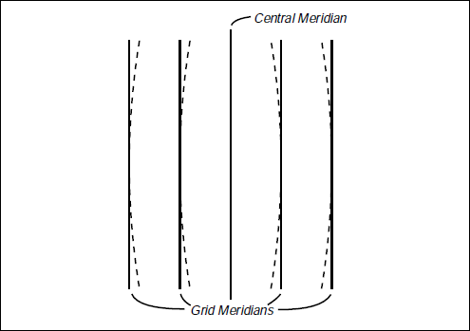
Grid Meridians
In plane surveys it is convenient to perform the work in a rectangular XY coordinate system in which one central meridian coincides with a true meridian. All remaining meridians are parallel to this central true meridian. This eliminates the need to calculate the convergence of meridians when determining positions of points in the system. The methods of plane surveying, assume that all measurements are projected to a horizontal plane and that all meridians are parallel straight lines. These are known as grid meridians.
The Oregon Coordinate System is a grid system.
Assumed Meridians
On certain types of localized surveying, it may not be necessary to establish a true, magnetic, or grid direction. However it is usually desirable to have some basis for establishing relative directions within the current survey. This may be done by establishing an assumed meridian.
An assumed meridian is an arbitrary direction assigned to some line in the survey from which all other lines are referenced. This could be a line between two property monuments, the centerline of a tangent piece of roadway, or even the line between two points set for that purpose.
The important point to remember about assumed meridians is that they have no relationship to any other meridian and thus the survey cannot be readily (if at all) related to other surveys
Azimuths
The azimuth of a line on the ground is its horizontal angle measured from the meridian to the line. Azimuth gives the direction of the line with respect to the meridian. It is usually measured in a clockwise direction with respect to either the north meridian or the south meridian. In plane surveying, azimuths are generally measured from the north.
When using azimuths, one needs to designate whether the azimuth is from the north or the south.
Azimuths are called true (astronomical) azimuths, magnetic azimuths, grid azimuths, or assumed azimuths depending on the type of meridian referenced.
Azimuths may have values between and 360 degrees.
16

Slide 17
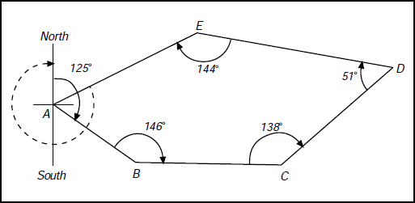
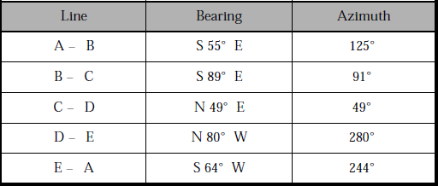
Practices for Azimuth and Bearings
Using angles to the right, calculate the bearings and azimuths of each lines.

Slide 18
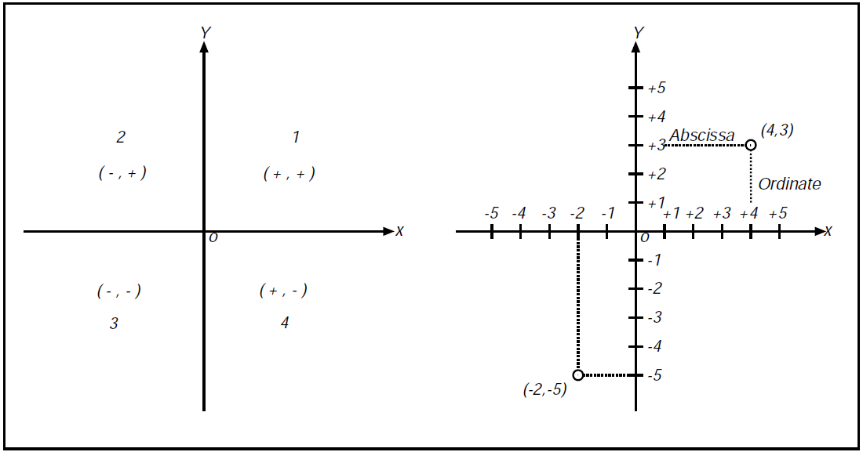
Co-ordinates
In Surveying, one of the primary functions is to describe or establish the positions of points on the surface of the earth. One of the many ways to accomplish this is by using coordinates to provide an address for the point. Modern surveying techniques rely heavily on 3 dimensional coordinates.
Rectangular Coordinate System (or Cartesian Plane)
In the right of figure, is what is described as a rectangular coordinate system. A vertical directed line (y-axis) crosses the horizontal directed line (x-axis) at the origin point. This system uses an ordered pair of coordinates to locate a point. The coordinates are always expressed as (x,y).
The x and y axes divide the plane into four parts, numbered in a counter-clockwise direction as shown in the left of figure 33. Signs of the coordinates of points in each quadrant are also shown in this figure.
Note: In surveying, the quadrants are numbered clockwise starting with the upper right quadrant and the normal way of denoting coordinates (in the United States) is the opposite (y,x) or more appropriately North, East.

Slide 19
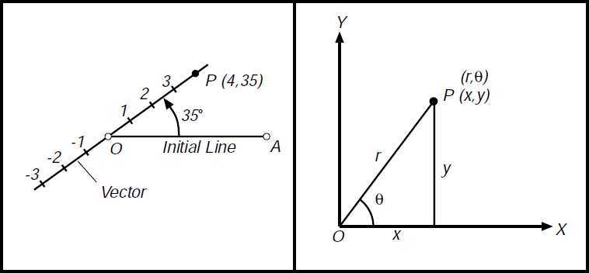
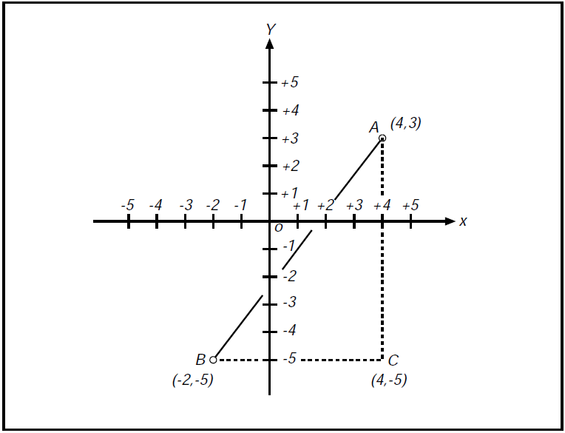
Polar Coordinates
Another way of describing the position of point P is by its distance r from a fixed point O and the angle θ that makes with a fixed indefinite line oa (the initial line). The ordered pair of numbers (r,θ) are called the polar coordinates of P. r is the radius vector of P and θ its vectorial angle.
Note: (r,θ), (r, θ + 360º), (-r, θ + 180º) represent the same point.
Transformation of Polar and Rectangular coordinates:
Measuring distance between coordinates
When determining the distance between any two points in a rectangular coordinate system, the pythagorean theorem may be used. In the figure below, the distance between A and B can be computed in the following way :

Slide 20
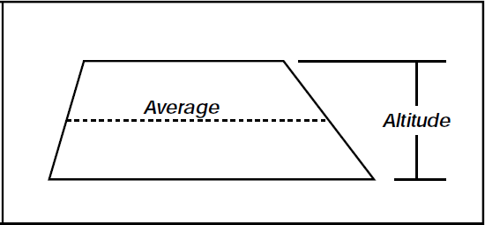
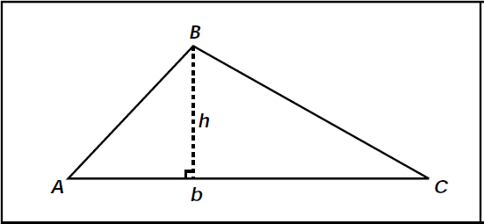
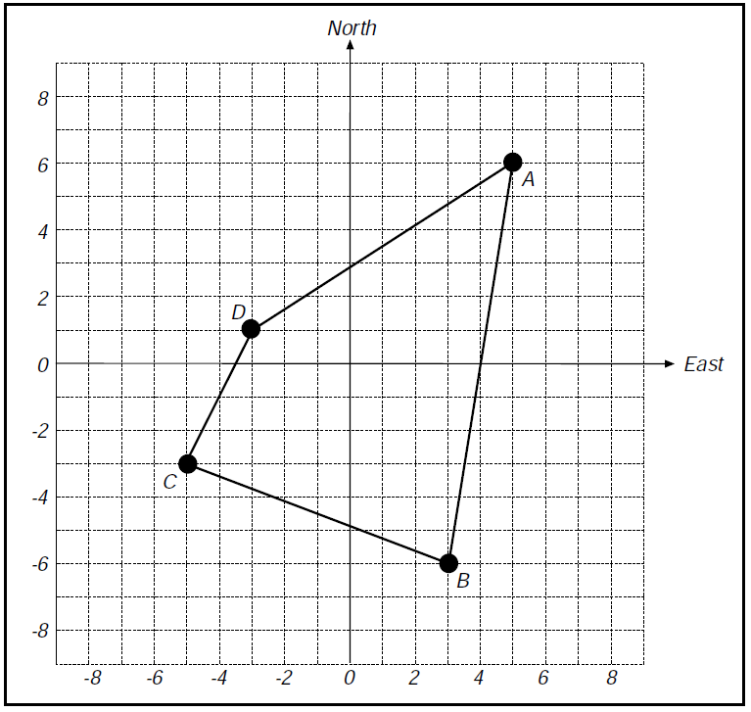
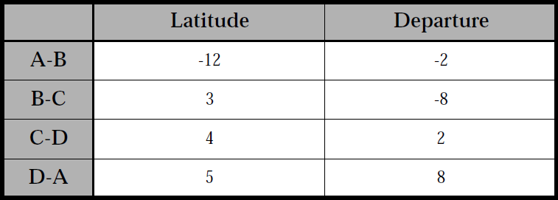

Measuring the Area by Coordinates
Area of a trapezoid: one-half the sum of the bases times the altitude. Area of a triangle: one-half the product of the base and the altitude.
Trapezoid
The area enclosed within a figure can be computed by coordinates. This is done by forming trapezoids and determining their areas.
Trapezoids are formed by the abscissas of the corners. Ordinates at the corners provide the altitudes of the trapezoids. A sketch of the figure will aid in the computations.
Triangle
Find the latitude and departure between points.
Find the area of the figure.
Answers

Slide 21
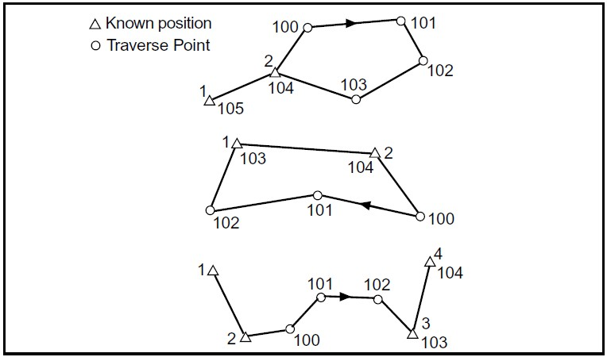
Traverse
A Traverse is a succession of straight lines along or through the area to be surveyed. The directions and lengths of these lines are determined by measurements taken in the field.
A traverse is currently the most common of several possible methods for establishing a series or network of monuments with known positions on the ground. Such monuments are referred to as horizontal control points and collectively, they comprise the horizontal control for the project.
In the past, triangulation networks have served as horizontal control for larger areas, sometimes covering several states. They have been replaced recently in many places by GPS networks. (GPS will be discussed in more detail later.) GPS and other methods capitalizing on new technology may eventually replace traversing as a primary means of establishing horizontal control. Meanwhile, most surveys covering relatively small areas will continue to rely on traverses.
Whatever method is employed to establish horizontal control, the result is to assign rectangular coordinates to
each control point within the survey. This allows each point to be related to every other point with respect to distance and direction, as well as to permit areas to be calculated when needed.
Types of traverses
There are several types or designs of traverses that can be utilized on any given survey. The terms open and closed are used to describe certain characteristics of a traverse. If not specified, they are assumed to refer to the mathematical rather than geometrical properties of the traverse.
A Geometrically Closed Traverse creates a closed geometrical shape, such as the first two examples in Figure
A. The traverse ends on one of two points, either the on same point from which it began or on the initial backsight.
The first two traverses in Figure A are geometrically closed.
Figure A

Slide 22
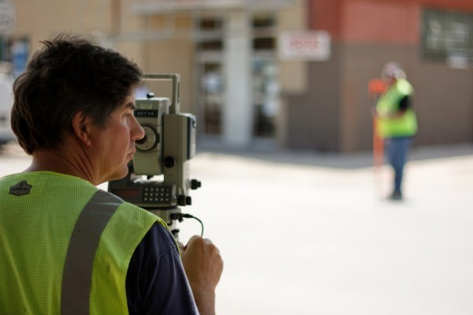
Procedure for running a traverse
To begin any traverse, a known point must be occupied. (To occupy a point means to set up and level the transit or theodolite, directly over a monument on the ground representing that point.) Next, a direction must be established. This can be done by sighting with the instrument a second known point, or any definite object, which is in a known direction from the occupied point. The object that the instrument is pointed to in order to establish a direction is known as a backsight. Possible examples would be another monument on the ground, a radio tower or water tank on a distant hill, or anything with a known direction from the occupied point. A celestial body such as Polaris or the sun could also be used to establish an initial direction.
Once the instrument is occupying a known point, for example point number 2, and the telescope has been pointed toward the backsight, perhaps toward point number 1, then an angle and a distance is measured to the first unknown point. An unknown point being measured to is called a foresight. With this data, the position of this point (lets call it point number 100) can be determined.
The next step is to move the instrument ahead to the former foresight and duplicate the entire process.

Slide 23
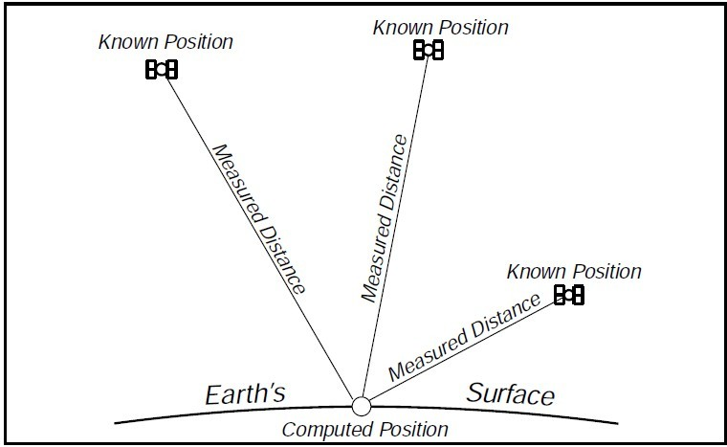
How satellite distance is measured
The Global Positioning System (GPS) is a navigational or positioning system developed by the United States Department of Defense. It was designed as a fast positioning system for 24 hour a day, three dimensional coverage worldwide.
It is based on a constellation of 21 active and 3 spare satellites orbiting 10,900 miles above the earth. The GPS (NAVSTAR) satellites have an orbital period of 12 hours and are not in geosynchronous orbit (they are not stationary over a point on the earth). They maintain a very precise orbit and their position is known at any given moment in time. This constellation could allow a GPS user access to up to a maximum of 8 satellites anywhere in the world.
GPS provides Point Position (Latitude/Longitude) and Relative Position (Vector). GPS can differentiate between
every square meter on the earth’s surface thus allowing a new international standard for defining locations and directions.
The Principles of GPS
For centuries man has used the stars to determine his position. The extreme distance from the stars made them look the same from different locations and even with the most sophisticated instruments could not produce a position closer then a mile or two. The GPS system is a constellation of Manmade Stars at an orbit high enough to allow a field of view of several satellites, yet low enough to detect a change in the geometry even if you moved a few feet.
A typical conventional survey establishes positions of unknown points by occupying a known point and
measuring to the unknown points. GPS is somewhat the opposite.
We occupy the unknown point and measure to known points. In conventional surveying this is similar to the process of doing a resection, the slight difference is that the targets are 10,900 miles away and travelling at extremely high
speeds.
23

Slide 24
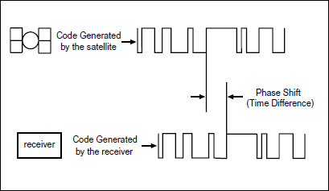
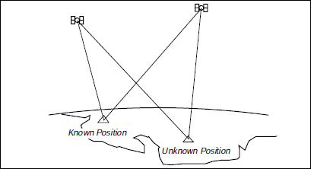
How satellite distance is measured
Each GPS satellite continually broadcasts a radio signal. Radio waves travel at the speed of light (186,000 miles per second) and if we measure how long it took for the signal to reach us we could compute the distance by multiplying the time in seconds by 186,000 miles per second.
In order to measure the travel time of the radio signal, the satellite broadcasts a very complicated digital code. The receiver on the ground generates the same code at the exact time and when the signal is received from the satellite, the receiver compares the two and measures the phase shift to
determine the time difference.
Differential GPS
To achieve sub-centimeter accuracies in positions, we need a survey grade receiver and a technique called Differential GPS. By placing a receiver at a known location, a total error factor which accounts for all the possible errors in the system, can be computed which can be applied to the position data of the other receivers in the same locale. The satellites are so high-up that any errors measured by one receiver could be considered to be exactly the same for all others in the immediate area.

Slide 25
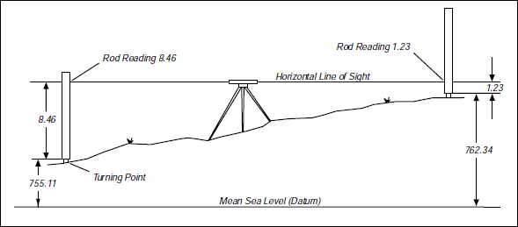
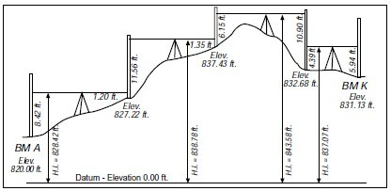
Differential Leveling
Differential leveling is the process used to determine a difference in elevation between two points. A Level is an instrument with a telescope that can be leveled with a spirit bubble. The optical line of sight forms a horizontal plane, which is at the same elevation as the telescope crosshair. By reading a graduated rod held vertically on a point of known elevation (Bench Mark) a difference in elevation can be measured and a height of instrument (H.I.) calculated by adding the rod reading to the elevation of the bench mark. Once the height of instrument is established, rod readings can be taken on subsequent points and their elevations calculated by simply subtracting the readings from the height of instrument.
In the following example, the elevation at BM-A is known, and we need to know the elevation of BM-K. The level is set up at a point near BM-A, and a rod reading taken. The height of instrument (HI) is calculated and a rod reading to a turning point (TP1) is taken. The reading of the foresight is subtracted from the height of instrument to obtain the elevation at TP1. The rod stays at TP1, the level moves ahead and the rod at TP1 now becomes the backsight. This procedure is repeated until the final foresight to BM-K.

Slide 26
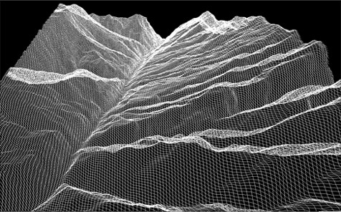
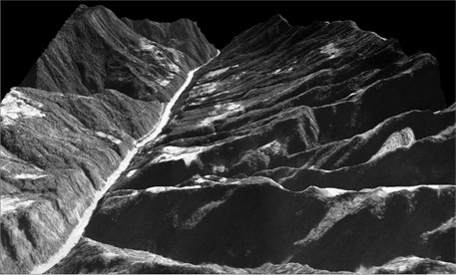
Digital Terrain Models
A digital Terrain Model (DTM) is numerical representation of the configuration of the terrain consisting of a very dense network of points of known
X,Y,Z coordinates. Modern surveying
and three
photogrammetric equipment enables rapid
dimensional data acquisition. A computer processes the data into a form from which it can interpolate a three dimensional position anywhere within the model.
Think of a DTM as an electronic lump of clay shaped into a model representing the terrain. If an alignment was draped on the model and a vertical cut made along the line, a side view of the cut line would yield the alignment’s original ground profile. If vertical cuts were made at right angles to the alignment at certain prescribed intervals, the side views of the cuts would represent cross sections. If horizontal cuts were made at certain elevation intervals, the cut lines when viewed from above would represent contours.
A DTM forms the basis for modern highway location and design. It is used extensively to extract profiles and cross sections, analyze alternate design alignments, compute earthwork, etc.
generates a "Digital Terrain Model" (DTM) from which it then automatically extracts a regular grid "Digital Elevation Model" (DEM).

Slide 27
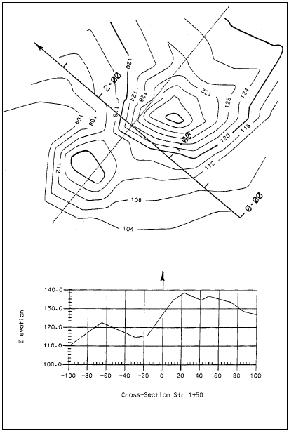
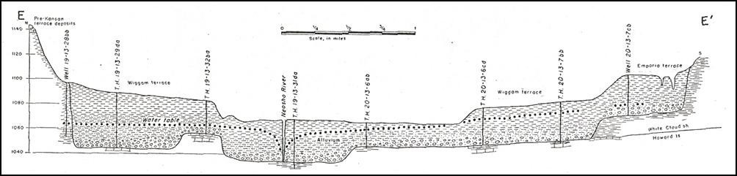
Cross Sections
Cross sections are lines 90 degrees perpendicular to the alignment (P-Line, L-Line, centerline of stream, etc.), along which the configuration of the ground is determined by obtaining elevations of points at known distances from the alignment.
Cross sections are used to determine the shape of the ground surface through the alignment corridor. The shape of the ground surface helps the designer pick his horizontal and vertical profile. Once the alignment is picked, earthwork quantities can be calculated. The earthwork quantities will then be used to help evaluate the alignment choice.
In addition to earthwork calculations, cross sections are used in the design of storm sewers, culvert extensions and the size and location of new culverts.
Example of alluvial terraces in a geologic cross section across the Neosho River Valley
Taken from O’Connor, 1953
27

Slide 28
References
Fundamentals of Surveying: Sample Examination,George M. Cole PE PLS (Author)
Basic Surveying,Raymond E Paul (Author), Walter Whyte (Author)
Electronic vs. Conventional Surveys,R. Dixon(Author)
http://squidstation.net/Surveying.html
www.ordnancesurvey.co.uk/gps/
Ninth Annual SeminarPresented by theOregon Department of TransportationGeometronics, Oregon
28

